Slide 1
SAFETY
LASER SENTINEL
December 2018

Slide 2
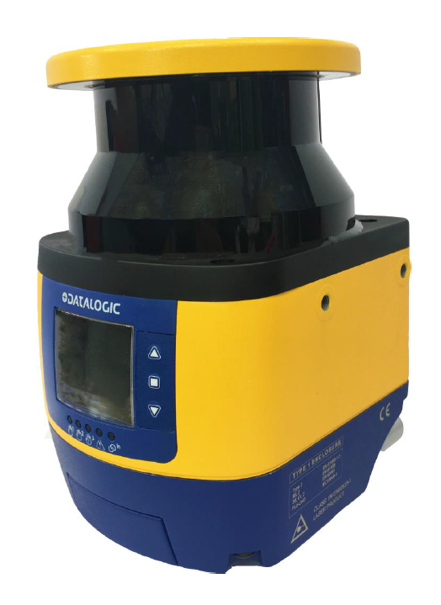
MASTER / SLAVE

Slide 3
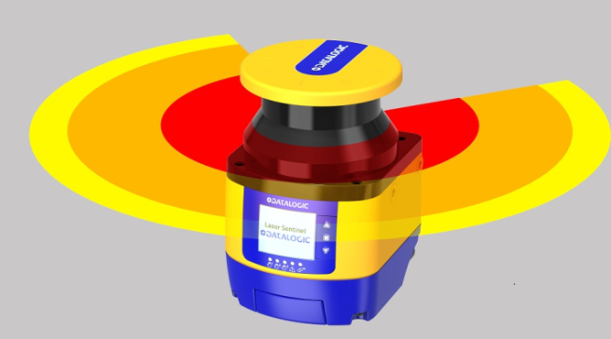
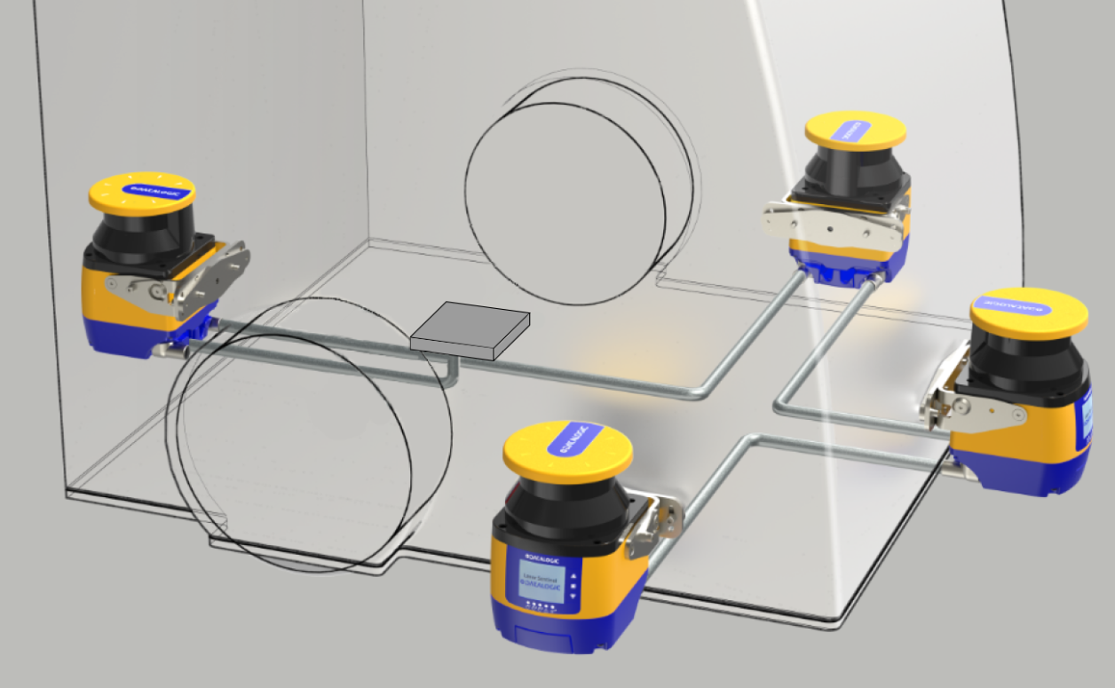
LASER SENTINEL
NEW
SLS-M/R
Jan. 19
SLS-SA5
Sep. 18
SLS-B5
Nov. 17

Slide 4
Laser Sentinel: models differences
NEW
Model: | BASE | STANDALONE | MASTER
 | SLS-B5 | SLS-SA5 | SLS-M5 + SLS-R5
HW FEATURES
Number of Pins in M12 connector | 8 | 8 | 12 OR 8
Pigtail connector | NO | YES | NO
Connector Group | YES | NO | YES
Rotating connectors | YES | NO | YES
FUNCTIONS
Detection capability | 70 | 40/70 | 40/70
Reference points for vertical applications | NO | YES | YES
Total Muting (override not possible (*1)) | NO | YES | YES
Measurement data output (not configurable) | NO | YES | YES
Total Muting (override possible) | NO | NO | YES
Master/Slave Connection | NO | NO | YES
Second safety zone | NO | NO | NO
Partial Muting | NO | NO | NO
Measurement data output (configurable) | NO | NO | NO
Fast replacement (memory backup) | NO | NO | NO
Window replacement | NO | NO | NO
Temperature range -10° | NO | NO | NO
Speed measurement (Encoder input) | NO | NO | NO

Slide 5
Laser Sentinel: models differences
Model: | BASE | STANDALONE | MASTER
 | SLS-B5 | SLS-SA5 | SLS-M5 + SLS-R5
INPUTS / OUTPUTS CONFIGURATION (USING THE MAX. INPUT CONFIGURATION AVAILABLE ON CONNECTORS)
Safety outputs (OSSDs) | 1x2 | 1x2 | 1x2
Standard Inputs (1st and 2nd connector) | 2 | 0 | 1
Standard Inputs/Standard Outputs (configurable) | 1 | 3 | 4
Standard Outputs | 0 | 0 | 0
High speed inputs | 0 | 0 | 0
ZONE SETS SWITCHING
Max. Zone sets number in any activation order (*2):
with 1 safety zone | 3 | 3 | 10
with 1 safety zone + 1 warning zone | 2 | 2 | 6
with 1 safety zone + 2 warning zone | 1 | 1 | 3
Max. Zone sets number in a particular activation order (*3): | N/A | 6 | N/A
Applications
Horizontal static Application (e.g. Robotic cells) | OK | OK | OK
Moving Appl. "low complexity" (eg. Simple AGV) |  | OK | OK
Vertical Application "low complexity" (eg. Access control and Muting without override/muting lamp) |  | OK | OK
Vertical Appl. "high complexity" (eg. With muting, override and muting lamp) |  |  | OK
Moving Appl. "high complexity" (eg. Complex AGV)
Overall Application coverage % | 45% | 55% | 65%
Notes
(*1) Impulsive override is available on SLS-SA but due to the limited number of I/Os, it can be used only if muting lamp is not connected to the scanner
(*2) 6 zone sets are available if they have 1 safey zone each. If zone sets have 1 safety and 1 warning zone, the zone sets available are 2.
(*3) Muting involves the complete safety zone ( total muting )
(*4) Measurement data protocol is the one used by DL Sentinel Monitoring function and it's not configurable
NEW

Slide 6
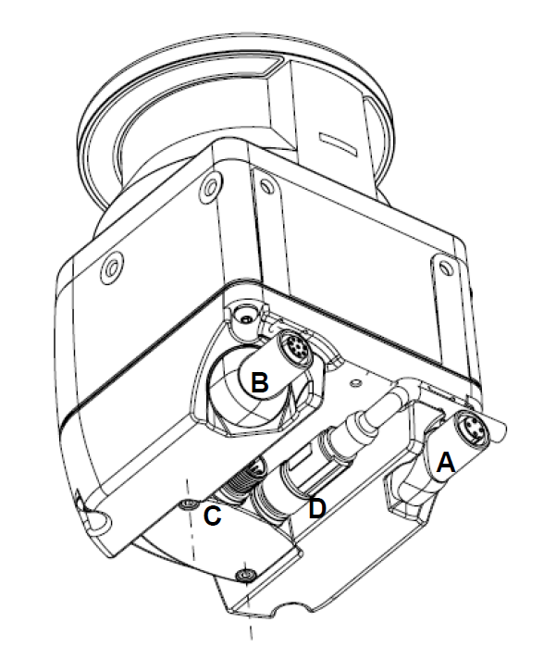
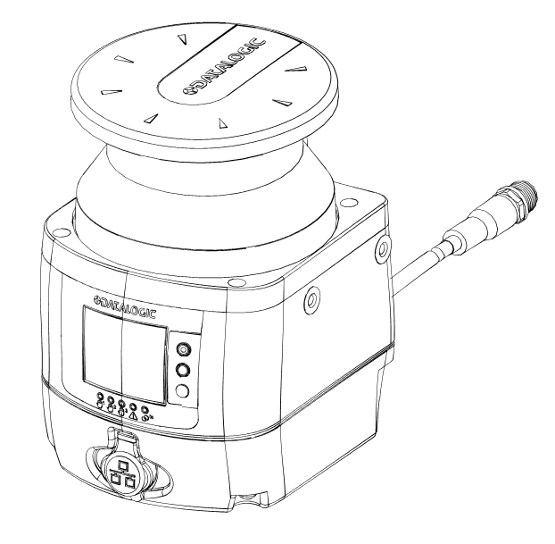
HW Differences
Master (SLS-M)
Standalone (SLS-SA)

Slide 7
MAIN FEATURES
Master Slave connection
Additional Inputs and Outputs (12 pins connector)
  More flexibility in applications
  Up to 10 zone sets
Two warning zones
40/70 mm detection capability
Muting and Override

Slide 8
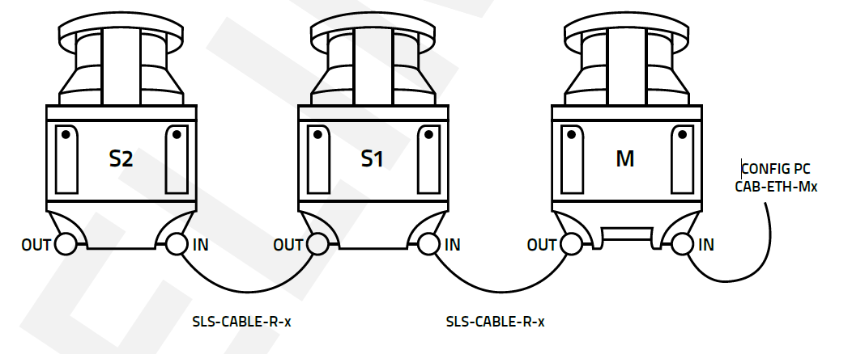
NEW
Master-Slave connection
Safe Ethernet-based connection between 1 Master (SLS-M5) and up to 3 Slaves (SLS-R5):
The complete system can be powered up, connected to the rest of the safety control system, programmed and monitored through the Master Ethernet port.
Safety and Warning zone can be split over Master and Slaves.
During the operation, the zone set changes of the Master are safely and seamlessly synchronized with the zone set changes of the Slaves.

Slide 9
Increased number of Zone Sets and I/Os
NEW
Increased number of Zone Sets (SLS-M):
Up to 3 Zone Sets composed of 1 Safe and 2 Warning Zones
Up to 6 Zone Sets composed of 1 Safe and 1 Warning Zone
Up to 10 Zone Sets composed of 1 Safe Zone.
12-pins or 8-pins M12 connector for digital I/O and power supply, according to application needs

Slide 10
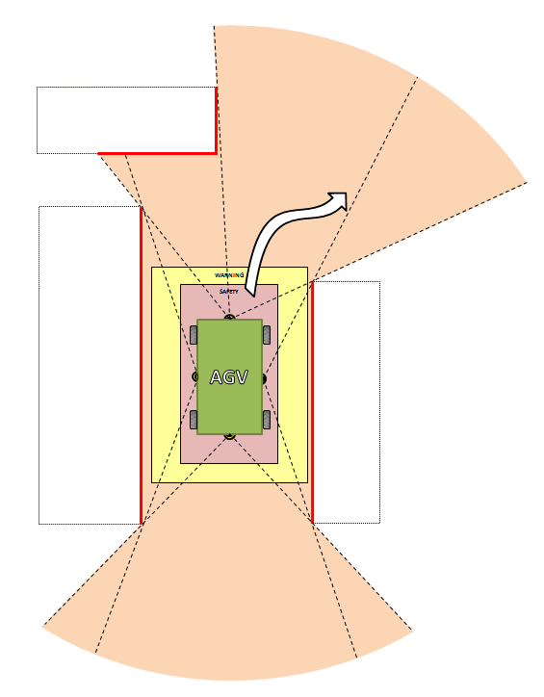
Key Selling Point: measurement data
NEW
A system of Master and Slaves can send out measurement data that can be used for
- direct navigation
- fine-tune the position of te vehicle in addition to navigation
The measurement protocol gives:
The distance of a point every 0.1° for Master
The distance of a point every 0.5° for each slave
A timestamp for each cycle of measurements

Slide 11

Features: Two Warning Zones
Safe zone maximum radius is linked to the detection (5.5m)
Warning zones can be designed up to 40 m
The second warning zone can be used for additional non-safe functionalities, i.e. :
Zone | Function | Safe Function
Warning 1 | Pre-alarm (sound/light) | No
Warning 2 | Slow down of movement | No
Safety | Stop | Yes
SLS-B5: 1 safe zone + 1 warning zone
SLS-SA5/SLS-M5 : 1 safe zone + 2 warning zones

Slide 12
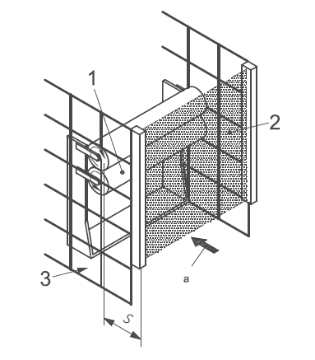
Features: 40/70 mm Detection
With SLS-SA5 and SLS-M5 the detection capability can be selected between 70 mm and 40 mm
For vertical applications, the distance calculation formula is
S=K*T+C
Where C is reduced if the resolution is 40 mm:
Detection capability | Max. Safety Radius | Additional safety distance to apply [C = 8*(d-14)]
40 mm | 3 m | 8 * ( 40 - 14 ) = 8 * 26 = 208 mm
70 mm | 5.5 m | 850 mm

Slide 13
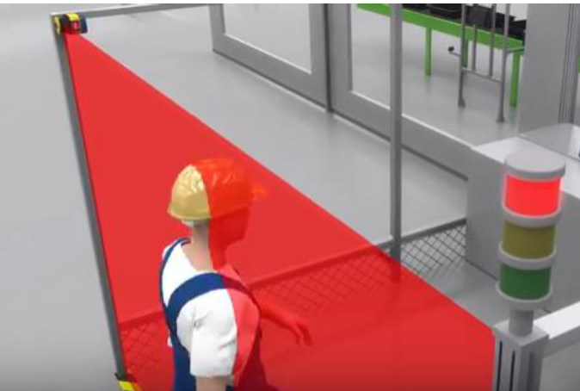
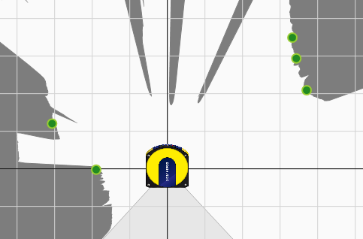
Reference Points
For vertical applications, safety norms require the use of reference points in order to check that the position of the device is not changing during the use.
The additional resolution of 40 mm allows to get closer to hazard point.

Slide 14
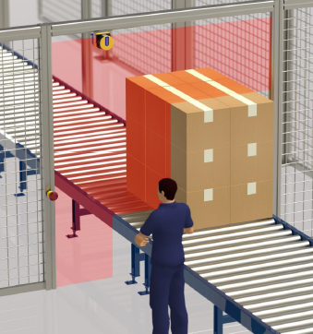
Features: Muting
SLS-SA5/SLS-M5 have integrated monodirectional (L) and bidirectional (T) muting function.
The muting area is covering all the safety area (Total Muting)
Muting lamp can be activated with non-safe output.
T and L muting follow the same rules of muting of Datalogic Safety Light Curtain (i.e. see SG4 EXTENDED), based on the status of 2 muting signals that have to be provided by external sensors or safety controller.
NEW
NOTE: due to limited number of I/O, on SLS-SA, override can be used only if muting lamp is not connected.
To use both override and muting lamp, use SLS-M

Slide 15
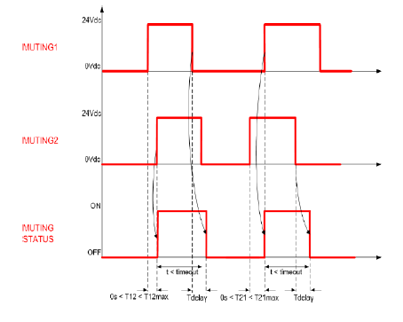
From SLS-B5 to SLS-SA
T muting (Bi-directional)
Parameters can be set up with DL Sentinel:
Inputs delay : from 1 to 16 seconds
Timeout: from 10 to 1080 minutes, or no timeout

Slide 16
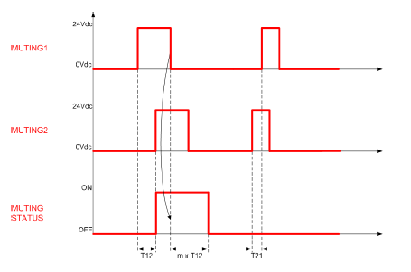
From SLS-B5 to SLS-SA
L Muting (Mono-directional)
Parameters can be set up with DL Sentinel:
Inputs delay : from 1 to 16 seconds
Timeout: from 10 to 1080 minutes, or no timeout
Muting coefficient (m): from 2 to 16
WARNING: L Muting (Monodirectional) can be used only when material exits from the dangerous zone.

Slide 17
Features: Override
The Override function allows the user to force the OSSDs to ON state whenever it is necessary to restart the machine, starting from a OFF Status of the Safety Laser Scanner ( detection of an object), and when one muting sensor is active.
The aim is clearing the protected area of any working materials blocked ahead of the device, because this interference may cause a work cycle anomaly.
With SLS-M5 it is possible to have
Single input line pattern (one input)
Level triggered input pattern ( two inputs )
Edge triggered pattern (two inputs)
SLS-SA5 has only
Single input line pattern (one input)
NOTE: in SLS-SA5, if muting lamp is used, override can’t be used.
NEW

Slide 18
Zone Set Switching
To switch between a zone set and the next one, digital inputs must be used in a way that permits to detect the single fault.
Depending on how many inputs can be used and how many inputs should be active in any of the valid configuration, the number of possible zone sets is given by the following table :
 |  | Numer of Inputs used (N)
 |  | 5 | 4 | 3 | 2
Active Inputs (R) | 1 | 5 | 4 | 3 | 2
 | 2 | 10 | 6 | 3 | NA
 | 3 | 10 | 4 | NA | NA
 | 4 | 5 | NA | NA | NA
 | 5 | NA | NA | NA | NA

Slide 19
Zone Set Switching
By consequence, depending on the composition of the Zone Sets, the maximum number of them is given by the following table:
NEW
 | Composition of Zone Set | Model and connector used
 |  | SLS-B5 | SLS-SA5 | SLS-M5
 |  | M12 8 pin | M12 8 pin | M12 8 pin | M12 12 pin
Max. Zone sets number in any activation order: | with 1 safety zone | 3 | 3 | 3 | 10
 | with 1 safety zone + 1 warning zone | 2 | 2 | 2 | 6
 | with 1 safety zone + 2 warning zone | N/A | N/A | N/A | 3
NOTE: Only for SLS-SA5, an exception is possible when the zone set is composed only by a safety zone: in that case, if the transitions between zone sets are following a particular rule, then the max zone set number using 3 inputs is 6 (refer to the manual for details)

Slide 20
APPLICATION EXAMPLES

Slide 21
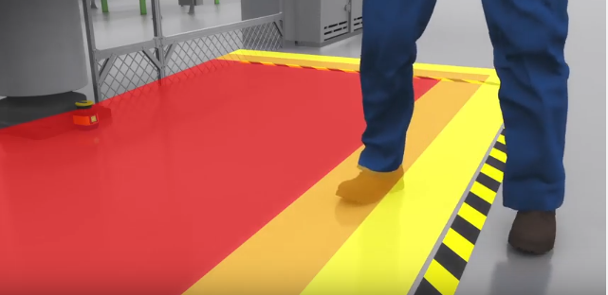
Applications: Horizontal
Robot cells :
  palletizing/depalletizing
  welding
  painting
  pick and place
  inspection and testing
  Others
Machinery or production lines with open sides, to facilitate operators interaction:
  cutting machines
  presses
  semi-automatic assembly machines and lines
  metal-working machines and lines

Slide 22
Horizontal Applications
Horizontal static applications
(access + monitoring presence)
Important features:
The second warning area
(ex. warning + slow down )
Autoteaching for simple design of areas
Zone set switching
ROBOT CELLS, GENERIC OPEN MACHINERY (EX. METAL WORKING, WOOD WORKING)

Slide 23
Horizontal Static Applications: examples
 | SLS-SA5
OSSD | 1 x 2
IN/OUT | 3
1 Safety zone: 2 OSSD
1 Warning zone: 1 output
FUNCTIONS
Manual restart ( 1 input ) AND Reset ( 1 input )

Slide 24
Horizontal Static Applications: examples
NEW
 | SLS-M5
OSSD | 1 x 2
IN | 1
IN/OUT | 4
1 Safety zone: 2 OSSD
1 Warning zone: 1 output
FUNCTIONS
Manual restart (1 input ) AND Reset (1 input ) AND
Clean Window alarm (1 output) AND General fault alarm (1 output )

Slide 25
Horizontal Static Applications: examples
 | SLS-SA5
OSSD | 1 x 2
IN/OUT | 3
1 Safety zone: 2 OSSD
2 Warning zone: 2 output
FUNCTIONS
Manual restart & Reset ( 1 input )

Slide 26
Horizontal Applications: examples
NEW
 | SLS-M5
OSSD | 1 x 2
IN | 1
IN/OUT | 4
1 safety zone: 2 OSSD
2 warning zones: 2 outputs
FUNCTIONS
1) Manual restart (1 input) AND Clean Window Alarm (1 output)
AND Reset (1 input)
2) Manual restart (1 input) AND General Fault Alarm (1 output)
AND Reset (1 input)

Slide 27
Horizontal Applications: examples
 | SLS-SA5
OSSD | 1 x 2
IN/OUT | 3
<
1 safety zone: 2 OSSD
1 warning zone: 1 output
2 SWITCHING BETWEEN ZONE SETS (2 inputs)
FUNCTIONS
Automatic restart
No manual restart
No Reset by wiring

Slide 28
Horizontal Applications: examples
 | SLS-M5
OSSD | 1 x 2
IN | 1
IN/OUT | 4
NEW
<
1 safety zone: 2 OSSD
1 warning zone: 1 output
2 SWITCHING BETWEEN ZONE SETS ( 2 inputs )
FUNCTIONS
Restart (1 input) + Reset by wiring ( 1 input )
Restart (1 input) + Clean Window Alarm/Generic Alarm (1 output)
Restart&Reset ( input) + Clean Window Alarm/Generic Alarm (1 output)

Slide 29
Horizontal Applications: examples
 | SLS-SA5
OSSD | 1 x 2
IN/OUT | 3
<
1 safety zone: 2 OSSD
No warning zone
3 SWITCHING BETWEEN ZONE SETS ( 3 inputs )
FUNCTIONS
Automatic restart
No manual restart
No Reset by wiring

Slide 30
Horizontal Applications: examples
NEW
 | SLS-M5
OSSD | 1 x 2
IN | 1
IN/OUT | 4
<
1 safety zone: 2 OSSD
1 warning zone: 1 output
3 SWITCHING BETWEEN ZONE SETS ( 3 inputs )
FUNCTIONS:
Manual restart (1 input)
Manual restart & Reset by wiring (1 input)
Clean Window Alarm (1 output)
Generic fault Alarm (1 output)

Slide 31
Horizontal Static Applications: examples
NEW
 | SLS-M5
OSSD | 1 x 2
IN | 1
IN/OUT | 4
<
1 safety zone: 2 OSSD
2 warning zones: 2 outputs
3 SWITCHING BETWEEN ZONE SETS ( 3 inputs )
FUNCTIONS:
Automatic restart

Slide 32
Horizontal Applications: examples
NEW
 | SLS-M5
OSSD | 1 x 2
IN | 1
IN/OUT | 4
1 Master + 1 Slave
1 safety zone: 2 OSSD
2 warning zone: 2 output
No switching of zones.
FUNCTIONS
Restart & Reset, Clean Window Alarm, Generic Fault Alarm
Only 2 OSSDs to connect at the robot safety system
Only one point for configuration and monitoring (Master)
Connection Master-Slave has also Power

Slide 33
Horizontal Applications: examples
 | SLS-M5
OSSD | 1 x 2
IN | 1
IN/OUT | 4
NEW
1 Master + 3 Slaves
1 safety zone: 2 OSSD
No switching of zones.
FUNCTIONS:
Only 2 OSSDs to connect at the robot safety system
Only one point for configuration and monitoring (Master)
Connection Master-Slave has also Power

Slide 34
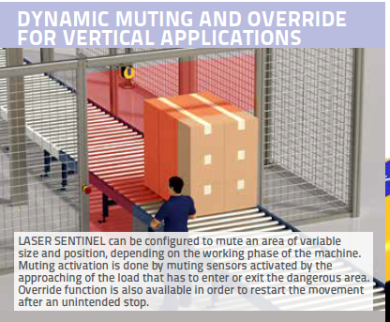
Applications: Vertical
In vertical applications there are two particular features available:
Monitoring the position of reference points ( mandatory by safety norm ) to avoid that the machine could go on working with a device displaced from its original position
SLS-B5: No vertical application
SLS-SA5 and SLS-M5: Vertical applications possible using Reference Points

Slide 35
Vertical Applications
Vertical applications (access monitoring)
The use in vertical position is safe for the introduction of reference points.
The resolution of 40 mm allows to get closer to hazard point.
Vertical applications with muting
The safety function is muted for the time needed for passage of material (mono and bidirectional).
ROBOT CELLS WITH LOAD/UNLOAD OPENINGS, PALLETIZERS/DEPALLETIZERS

Slide 36
Vertical Applications
 | SLS-SA5
OSSD | 1 x 2
IN/OUT | 3
1 safety zone: 2 OSSD
No switching of zones.
FUNCTIONS
Manual Restart AND Reset
No Muting

Slide 37
Vertical Applications
 | SLS-SA5
OSSD | 1 x 2
IN/OUT | 3
1 safety zone: 2 OSSD
No switching of zones.
FUNCTIONS
Muting ( 2 inputs )
Manual restart OR Single line Override OR Muting Lamp OR Muting Enable

Slide 38
Vertical Applications
NEW
 | SLS-M5
OSSD | 1 x 2
IN | 1
IN/OUT | 4
1 safety zone: 2 OSSD
No switching of zones.
FUNCTIONS
Muting ( 2 inputs )
Manual Restart AND Single line Override AND Muting Lamp
Muting Enable AND Single line Override AND Muting Lamp
Manual Restart&Reset AND Single line Override AND Muting Lamp
Manual Restart&Reset AND Muting Lamp AND CleanWindow

Slide 39
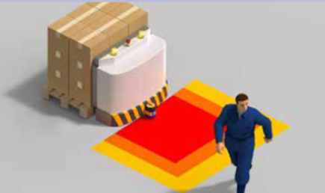
Moving applications
Horizontal moving applications
( anti-collision )
Important features:
Warning zones
Zone set switching
Measurement data
AUTOMATED GUIDED VEHICLES, AUTOMATED GUIDED CARTS WITH SIMPLE MOVEMENTS

Slide 40
Moving Applications with SLS-SA
3 Zone sets available
(3 inputs)
(6 with limitations on transitions)
2 Zone sets available
(2 inputs)
1 Zone set available
The zone set switching inputs must be given to all scanners
1 safety zone: 2 OSSD x each scanner
FUNCTIONS
Automatic restart
 | SLS-SA5
OSSD | 1 x 2
IN/OUT | 3

Slide 41
Movable applications with SLS-M
NEW
10 Zone sets available
(5 inputs )
6 Zone sets available
(4 inputs)
3 Zone set available
(3 inputs)
The zone set switching inputs must be given only to Master
1 safety zone: 2 OSSD for up to 4 scanners
FUNCTIONS
Automatic restart
 | SLS-M5
OSSD | 1 x 2
IN | 1
IN/OUT | 4

Slide 42
Movable Applications with SLS-M
NEW
6 Zone sets available
(4 inputs )
3 Zone sets available
(3 inputs)
3 Zone set available
(3 inputs)
The zone set switching inputs must be given only to Master
1 safety zone: 2 OSSD for up to 4 scanners
FUNCTIONS
Automatic restart AND Clean Window Alarm
Automatic restart AND General Fault Alarm
 | SLS-M5
OSSD | 1 x 2
IN | 1
IN/OUT | 4

Slide 43
COMPETITION

Slide 44
Selling Against
NEW

Slide 45
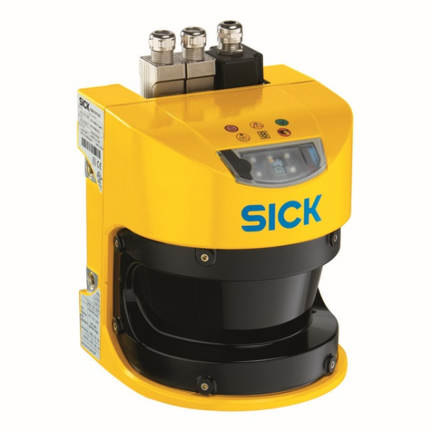
SICK S3000
Range: 4 / 5,5 / 7 m x 190°
Resolutions: 30/40/50/70/150 mm
Min response time: 60ms
Safe Communication: EFI, Profisafe (on special models)
Measured data output: RS422
Dimensions ( W x H x D ): 155 x 185 x 160 mm
Reliability in industrial environment: High
Type | Standard | Advanced | Professional | Expert/Remote
#Field sets | 1 ( 4 with EFI) | 4 | 8 | 21 ( 32 with EFI)
Encoder Input |  |  | YES | YES

Slide 46
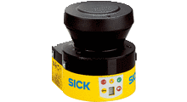
SICK
S300 mini
Range: 2 / 3 m x 270°
Resolutions: 30/40/50/70/150 mm
Min response time: 80ms
Safe Communication: EFI (only remote)
Measured data output: RS422
Dimensions ( W x H x D ): 102 x 116 x 105
Reliability in industrial environment : Normal
#Field sets: 16 (only with EFI controller)
Encoder input: NO

Slide 47
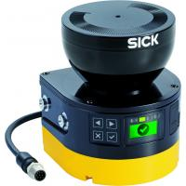
SICK
Microscan 3
Range: 5.5 m x 275°
Resolutions: 30/40/50/70/150 mm
Min response time: 90 ms, 70 ms (NOTE: with 70ms, the range is reduced to 4m)
No measuring data
Dimensions ( W x H x D ): 112 x 135 x 111
Reliability in industrial environment : High
No muting
#Field sets:
CORE: 2;
CORE ETHERNET IP/PROFISAFE: 8
PRO ETHERNET IP/PROFISAFE: 128
Encoder input: NO

Slide 48
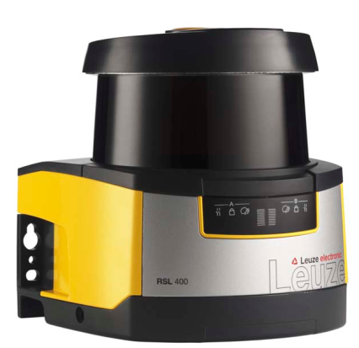
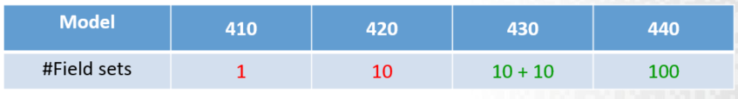
LEUZE
RSL
Range: 3, 4.5, 6.25, 8.50 m x 270°
Resolutions: 30/40/50/70/150 mm
Min response time: 80ms
Safe Communication: NO
Measured data output: NO
Reliability in industrial environment : Normal

Slide 49
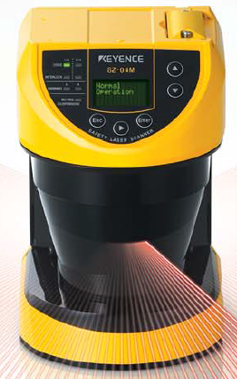
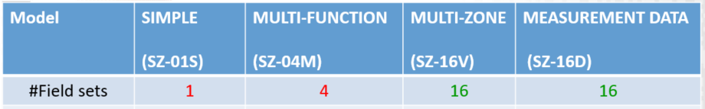
KEYENCE SZ
Range: 4,2 x 190° & 2,8 x 270°
Resolutions: 30/40/50/70/150 mm
Min response time: 60ms
Safe Communication: NO
Measured data output: RS422 ( only SZ-16D)
Configuration PC/Pushbuttons ( simple shapes)
Reliability in industrial environment : High

Slide 50
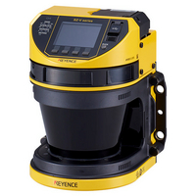
KEYENCE
SZ-V
Range: 8.4m x 190°
Master /Slave connection of 3
Muting Function
Resolutions: 20/30/40/50/70/150 mm
Min response time: 80ms/160ms (NOTE: with min response time the range is reduced to 5,7m)
Safe Communication: NO
Measured data output: Ethernet UDP (only SZ-V32N))
Configuration PC/Pushbuttons (for simple shapes)
Reliability in industrial environment : High
Optional Camera (only ‘X’ models)
Removable display with image
Dimensions: 125 x 180 x 130
Model | SZ-V04 | SZ-V32 | SZ-V32N
#Field sets | 4 | 32 | 32
Measurement | NO | NO | YES

Slide 51
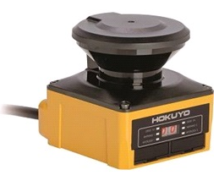
HOKUYO
UAM-05LP-T301
Range: 5 x 270°
Master /Slave connection of 4
Muting Function
Resolutions: 30/50/70 mm
Min. response time: 60ms
Measured data output: yes
Backup memory: yes (SD on the front)
Reliability in industrial environment : low
Dimensions: 80 x 95 x 80
#Field sets: 32
Measurement: YES

Slide 52
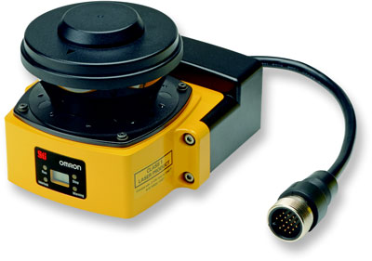
OMRON
OS32C
Range: 4 m x 270°
Resolutions: 30/40/50/70 mm
Min. response time: 80ms
Measured data output: YES ( model OS32C-DM)
Reliability in industrial environment : Medium
#Field sets: 70

Slide 53
REVIEW

Slide 54
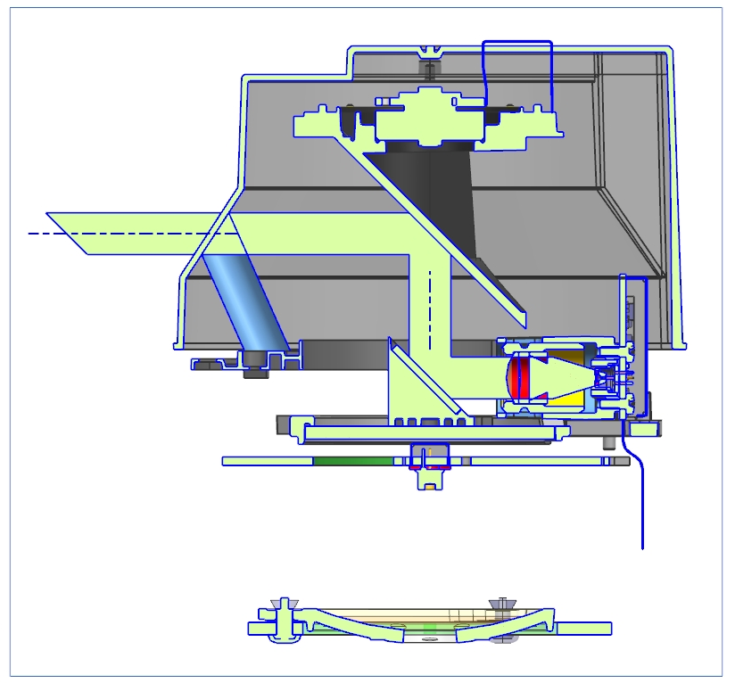
Optic Architecture
What’s a safety laser scanner
Window
Body
Motor
Rotating
mirror
Bending
mirror
Laser
Emitter
Receiver
Aspheric
mirror

Slide 55
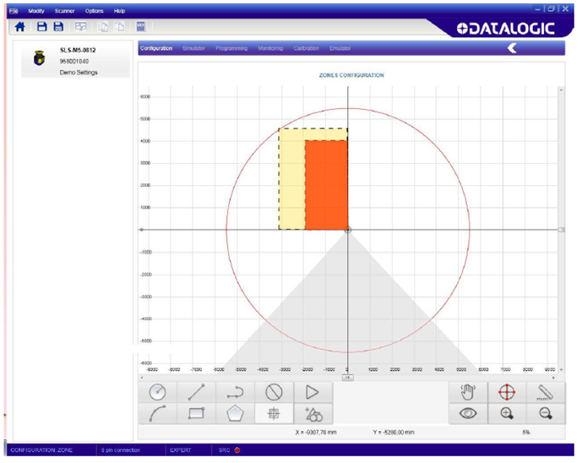
Graphic User Interface

Slide 56
Specifications
Type (EN61496-1): 3
PL (EN ISO 13849-1): d
SIL (IEC 61508): 2
Resolution: 40/70 mm selectable
Max safety distance: 5.5 m
Opening angle: 275°
Minimum response time: 62 ms
Power supply (Vdd): 24 Vdc ± 20%
Programming, monitoring and measurement data: Ethernet
Dimensions (w,h,d): 102 , 152, 112.5 mm
Operating temperature: 0°C …+50 °C
Humidity: 15 … 95 % (no condensation)
Mechanical protection: IP65
SLS-B5: Resolution:70 mm; max. Distance: 5.5 m
SLS-SA5 and SLS-M5: Resolution: 40/70 mm; max distance 3/5.5 m

Slide 57
Available Zones
One «set» is formed by max. 3 zones
The configuration of zones can be:
1 safe (2 OSSDs)
1 warning (1 standard output)
1 safe (2 OSSDs)
2 warning (2 standard outputs)
• Maximum distances for safe zones:
up to 5.5 m for 70 mm resolution
up to 3 m for 40 mm resolution
• Maximum distances for warning zones:
up to 40 m for 70 mm resolution
up to 22 m for 40 mm resolution
SLS-B5: 1 safe zone + 1 warning zone
SLS-SA5 and SLS-M5 : 1 safe zone + 2 warning zones

Slide 58
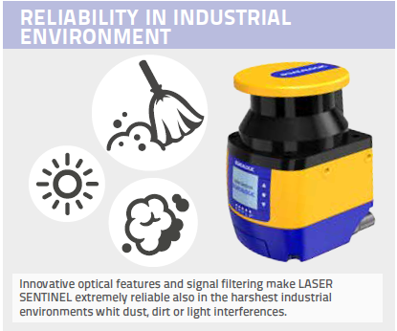
Key Selling Point: Reliability
To reach the target of the maximum reliability of behcaviour even in environment with dirth, dust, and light sources, a series of HW and SW filters have been designed since the early stage of project.
Internal tests have given excellen results in comparison with competitors products.
The SW dust filter is configurable in GUI, allowing the customer to choose the level needed.
SLS-B5: Dust filter is limited to safety zone
SLS-SA5 and SLS-M5 : Dust filter can be applied also to warning zone

Slide 59
Target Applications
Horizontal Static Applications | Robot cells «Open machinery» | Automotive Metal working Wood working Generic
Vertical Static Applications | Palletizers/Depalletizers Conveyors | Secondary Packaging Material Handling
Moving Applications | Automated Guided Vehicles (AGV) Automatic Guided Carts (AGC) | Material Handling Intralogistics

Slide 60
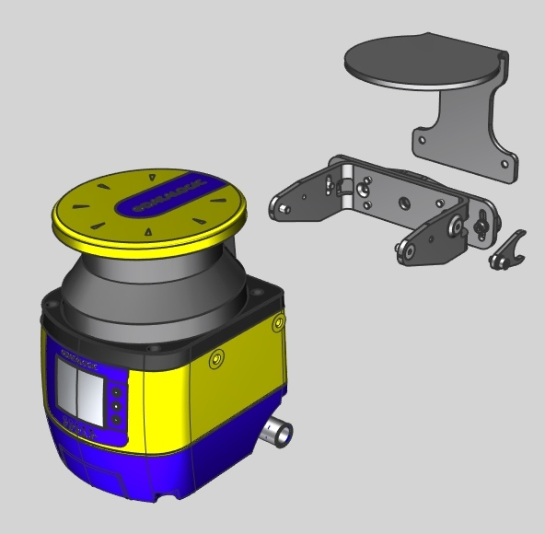
Mounting System

Slide 61
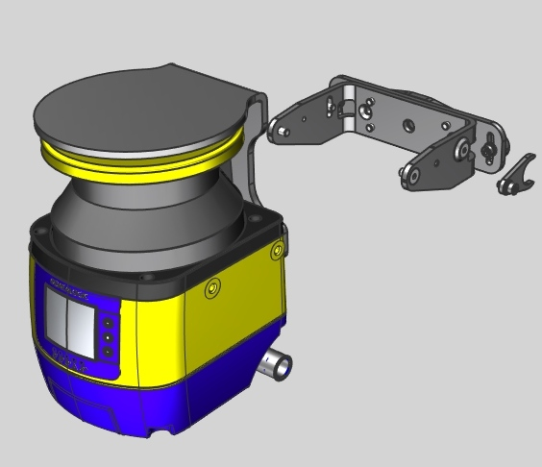
Brackets
SLS-BRACKET-A
2-rotations bracket
SLS-BRACKET-C
Optional protection
SLS-BRACKET-B
1-rotation bracket
Position memory bracket (saves the inclination angle)

Slide 62
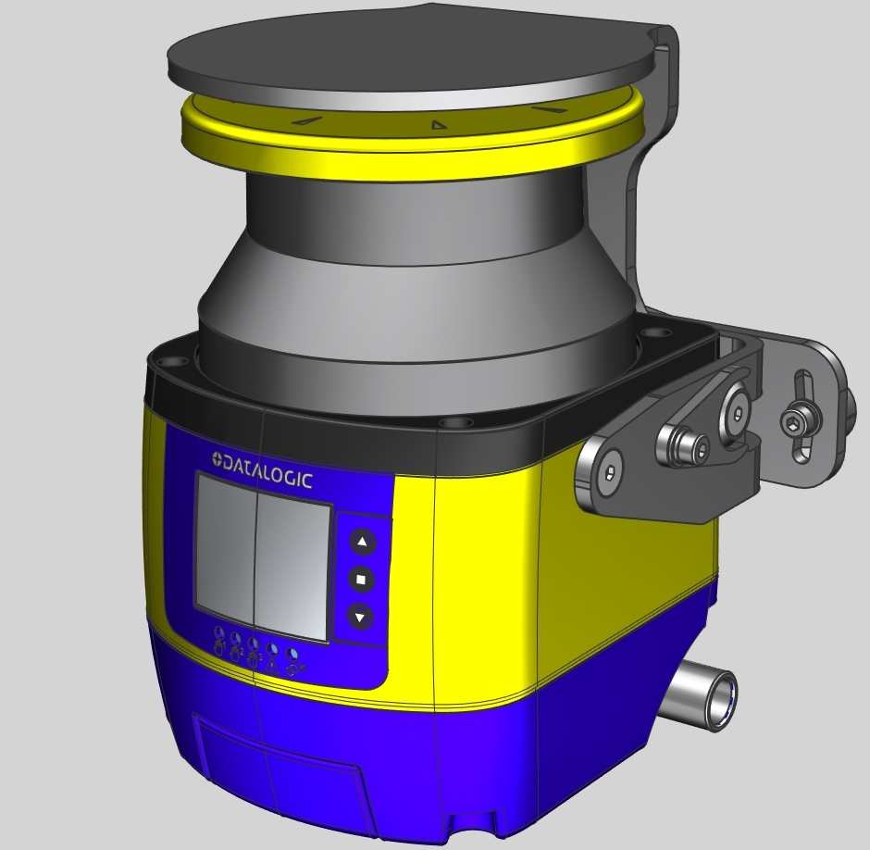
Complete Mounting System

Slide 63
Datalogic S.r.l.
DATALOGIC S.R.L.
Via San Vitalino, 13 - 40012 Lippo di Calderara di Reno (BO)
Italy
Website: www.datalogic.com
SP-LASER-SENTINEL_MASTER-SLAVE-ENA4 Rev A 20181205

